Slide 1

I Installed SQL… Now what?

Slide 2

Jared Karney
@sqlknowitall
http://www.sqlknowitall.com
jared.karney@gmail.com

Slide 3
Agenda
Best practices for install
Setup of process
Build checklist
Config scripts, procedures, and why!

Slide 4
Best Practices/Requirements for Install
Separate service accounts for Engine and Agent (and of course for this instance vs others)
Power Settings - High Performance
Windows updates disabled
Hyperthreading enabled
You or DBA group Local Admin (needed for install)
.NET 3.5 installed
UAC disabled
Firewall disabled/set up properly
Separate disks for SQL binaries, user data, user logs, system databases less tempdb, tempdb, DBA database
Disks formatted with 1024kb offset
Data and log disks formatted with 64kb allocation unit

Slide 5
Install SQL
Add yourself or DBA team as Sysadmins
Install only what you need
Instance root to SQL Binaries drive
Shared features to C:\
Data root directory is where System databases go
Change user data, user log, tempdb, tempdb log, and backup directory paths
Change SQL Agent to “Automatic” startup
SQL 2016 – Add tempdb files during install!!!

Slide 6

ALL DONE!

Slide 7


Slide 8
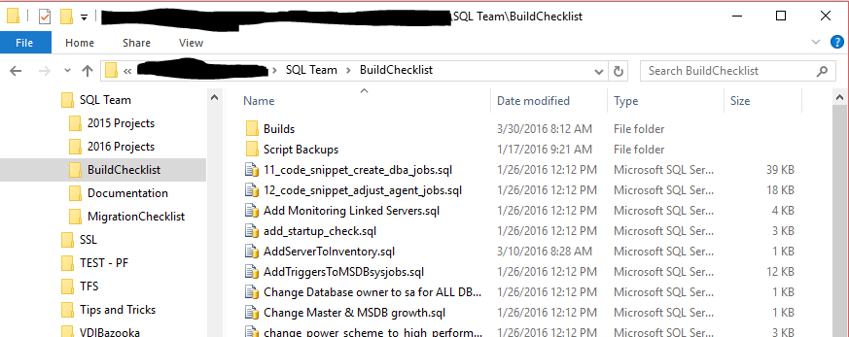
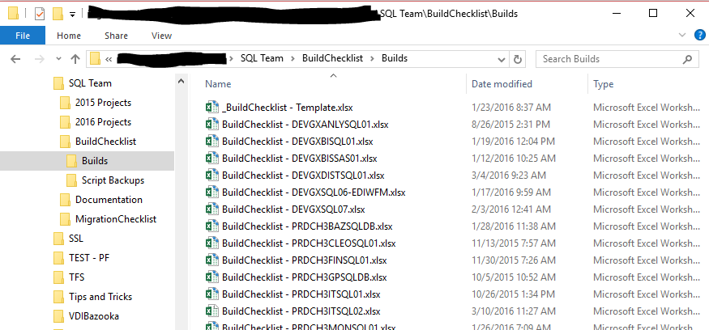

Slide 9
DEMO

Slide 10
Key Points
Always send information to server team; never assume they have their own checklist for SQL
Always verify drives BEFORE installing SQL
Be consistent
Verify verify verify…

Slide 11
Thanks!!!
Jared Karney
@sqlknowitall
http://www.sqlknowitall.com
jared.karney@gmail.com

